Slide 1




NETFLIX Data
Cleaning, Analysis and Visualization using python &
powerbi
-Subhadeep Mondal

Slide 2
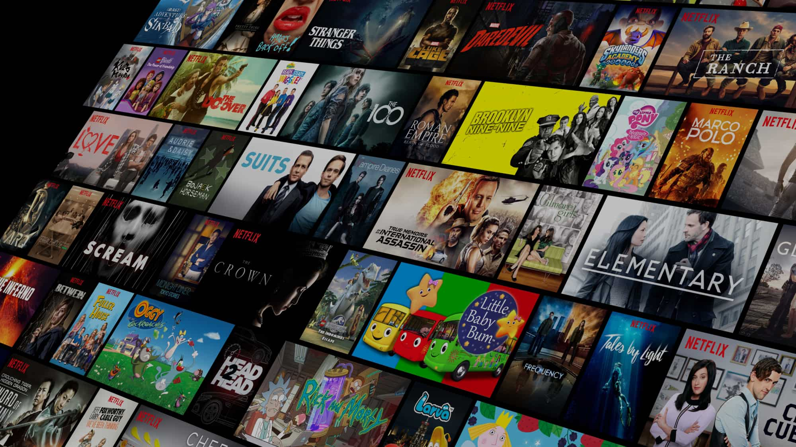

PROJECT NAME : EDA ON NETFLIX MOVIES AND SERIALS
NAME:SUBHADEEP MONDAL
ID:231001001059
BATCH:BCS3C,TECHNO INDIA UNIVERSITY
MOB NO: 8240535235
EMAIL:SUBHADEEP231001001059@technoindiaeducation.com

Slide 3


OBJECTIVE
This project aims to analyze Netflix’s content library by:
Importing & Cleaning Data using Python (Pandas) & Power BI.
Exploring Content Trends (Movies vs. TV Shows, Genre Distribution, Ratings).
Visualizing Data with Power BI (Bar Charts, Line Charts, Heatmaps, Maps).
Building an Interactive Dashboard to provide insights into:
Top Countries Producing Netflix Content.
Most Featured Directors.
Content Ratings & Yearly Trends.
Extracting Key Insights to understand content strategies & audience engagement

Slide 4
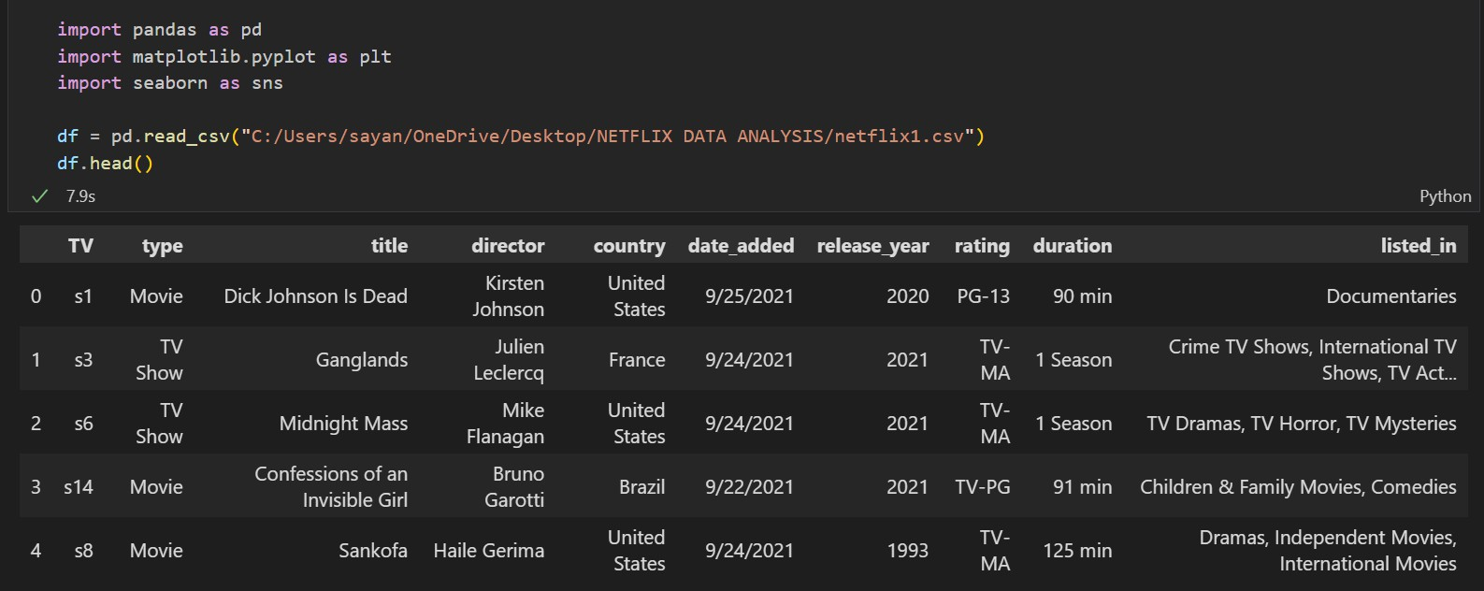
Importing Libraries and Modules

Slide 5




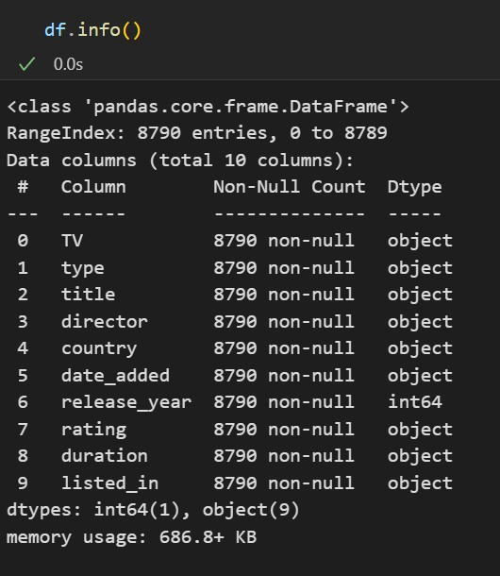





CHECKING THE INFO

Slide 6
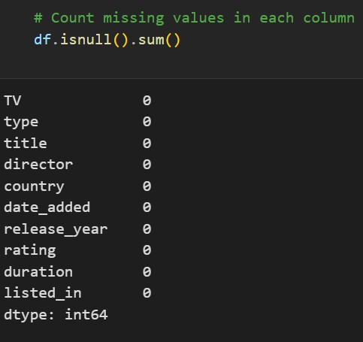
DATA CLEANING
Checking for Null
Values

Slide 7


DATA CLEANING
Check for duplicate rows
and drop (if exist)

Slide 8

DATA VISUALIZATION

Slide 9
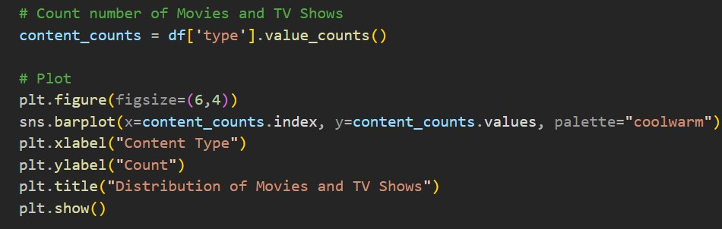
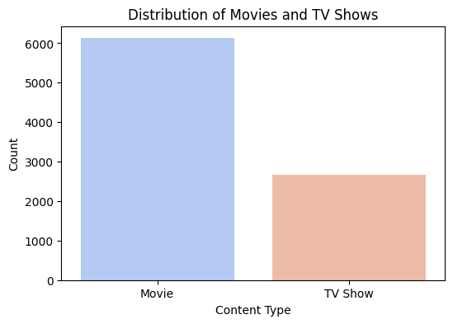
DISTRIBUTION OF MOVIES & TV SHOWS

Slide 10
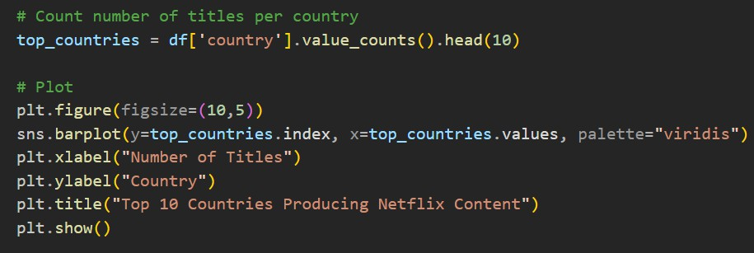
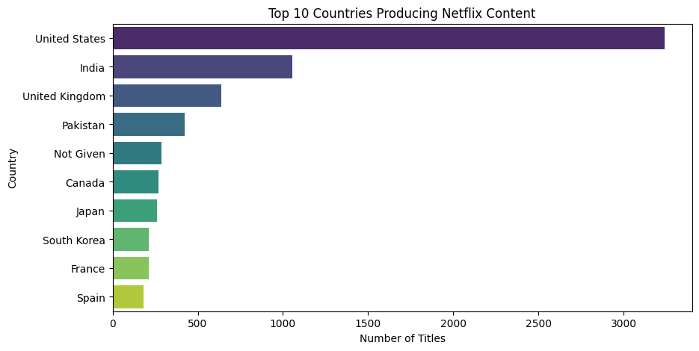
TOP 10 COUNTRIES PRODUCING NETFLIX CONTENT

Slide 11
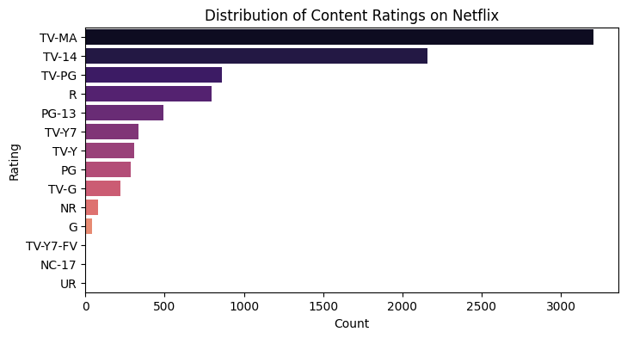
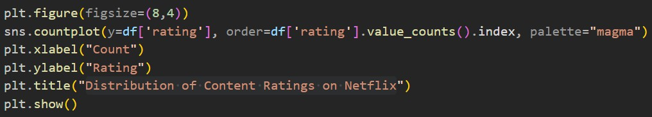
DISTRIBUTION OF CONTENT RATINGS ON NETFLIX

Slide 12
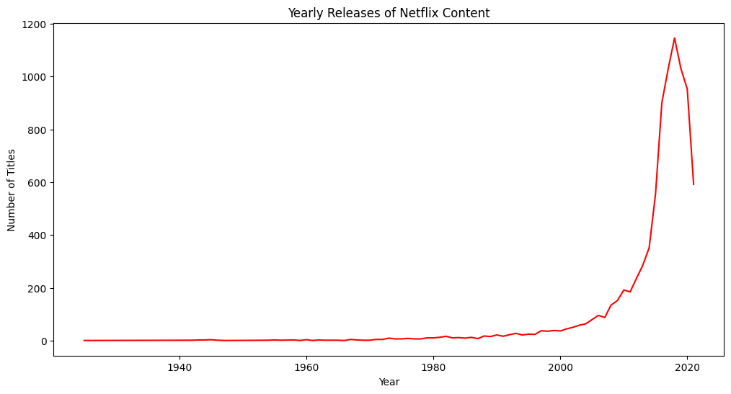
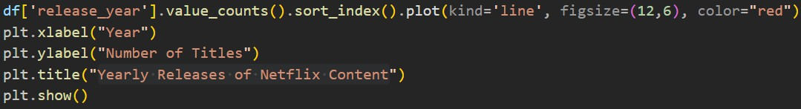
YEARLY RELEASES OF NETFLIX CONTENT

Slide 13
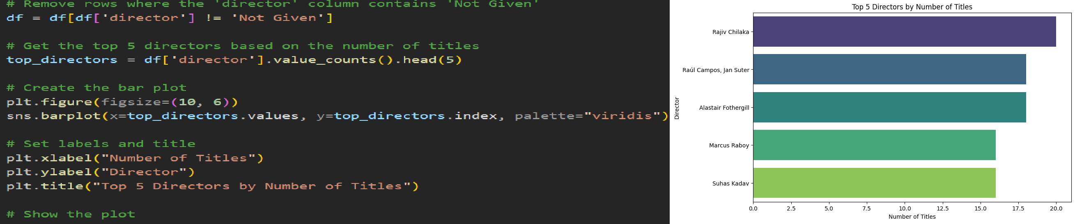
TOP 10 MOST FEATURED DIRECTORS ON NETFLIX

Slide 14





KEY INSIGHTS
1️⃣ Content Distribution (Movies vs. TV Shows)
Movies dominate Netflix’s library with approximately 70% of total content, while TV Shows make up the remaining 30%. Netflix has focused more on Movies than TV Shows over the years, but TV Show production has increased recently.
2️⃣ Top Countries Producing Netflix Content
United States, India, and the United Kingdom are the top 3 content-producing countries.
India has a rapidly growing presence, producing a significant number of Movies & TV Shows.
Countries like Canada, France, and Spain also contribute significantly to the platform’s global content.
3️⃣ Most Featured Directors
The top 5 most featured directors on Netflix are: 1.Rajiv Chilaka 2.Alastair Fothergill 3.Raul Campos 4.Marcus Raboy 5.Suhas Kadav
These directors specialize in genres such as Documentaries, International Dramas, and Stand-Up Comedy. Some directors have worked across multiple countries, increasing Netflix’s global appeal.
4️⃣ Genre Trends & Popularity
Top Genres on Netflix: 1.International Dramas 2.Documentaries 3.Stand-Up Comedy

Slide 15




KEY INSIGHTS (CONTD.)
5️⃣ Ratings Distribution – Audience Preferences
TV-MA (Mature Audience) is the most common rating, followed by TV-14 and TV-PG. Kids’ content (TV-Y, TV-G) makes up a small portion of Netflix’s catalog.
Netflix focuses heavily on adult and teen audiences, aligning with the popularity of Drama, Thriller, and Documentary genres.
6️⃣ Yearly Content Growth
Netflix content production has grown significantly post-2000, with an exponential increase after 2015.
COVID-19 (2020-2021) caused a slight shift in production trends, with more TV Shows being released compared to Movies. The highest number of releases happened in [Year X], showing Netflix’s expansion in content creation.
7️⃣ Map Insights – Content Globalization
The US remains the dominant content producer, but Netflix’s investment in non-English content is growing.
Countries like South Korea, Spain, and Brazil have seen an increase in Netflix Originals, indicating the platform’s expansion into regional markets. Bollywood & K-Dramas contribute significantly to Netflix’s diverse content library.

Slide 16
Challenges & Solutions
Challenges :-
During the course of analysis, several technical and analytical challenges were encountered. The following summarizes the key issues and their corresponding solutions:
1.Missing and Incomplete Data:Many records lacked details such as director, cast, and country, reducing data reliability.
2.Inconsistent Data Formats:Variations in date and categorical entries made data cleaning difficult.
3.Genre and Country Overlap:Some titles contained multiple genres or countries, leading to data redundancy.
4.Visualization Clutter:Large data size created overcrowded plots that were hard to interpret clearly.Solutions Implemented.

Slide 17
Challenges & Solutions
Solutions Implemented:
1.Handled missing values using data imputation and removal techniques.Standardized date formats and split multi-valued fields into manageable components.
2.Filtered top genres and countries for clearer, focused visualizations.Utilized aggregation and grouping functions in Pandas for concise trend representation.
3.Enhanced plot readability by applying customized color palettes and titles.
Overall, the project successfully provided valuable insights into Netflix’s dataset while strengthening skills in data preprocessing, visualization, and analytical interpretation.

Slide 18

POWER BI DASHBOARD

Slide 19

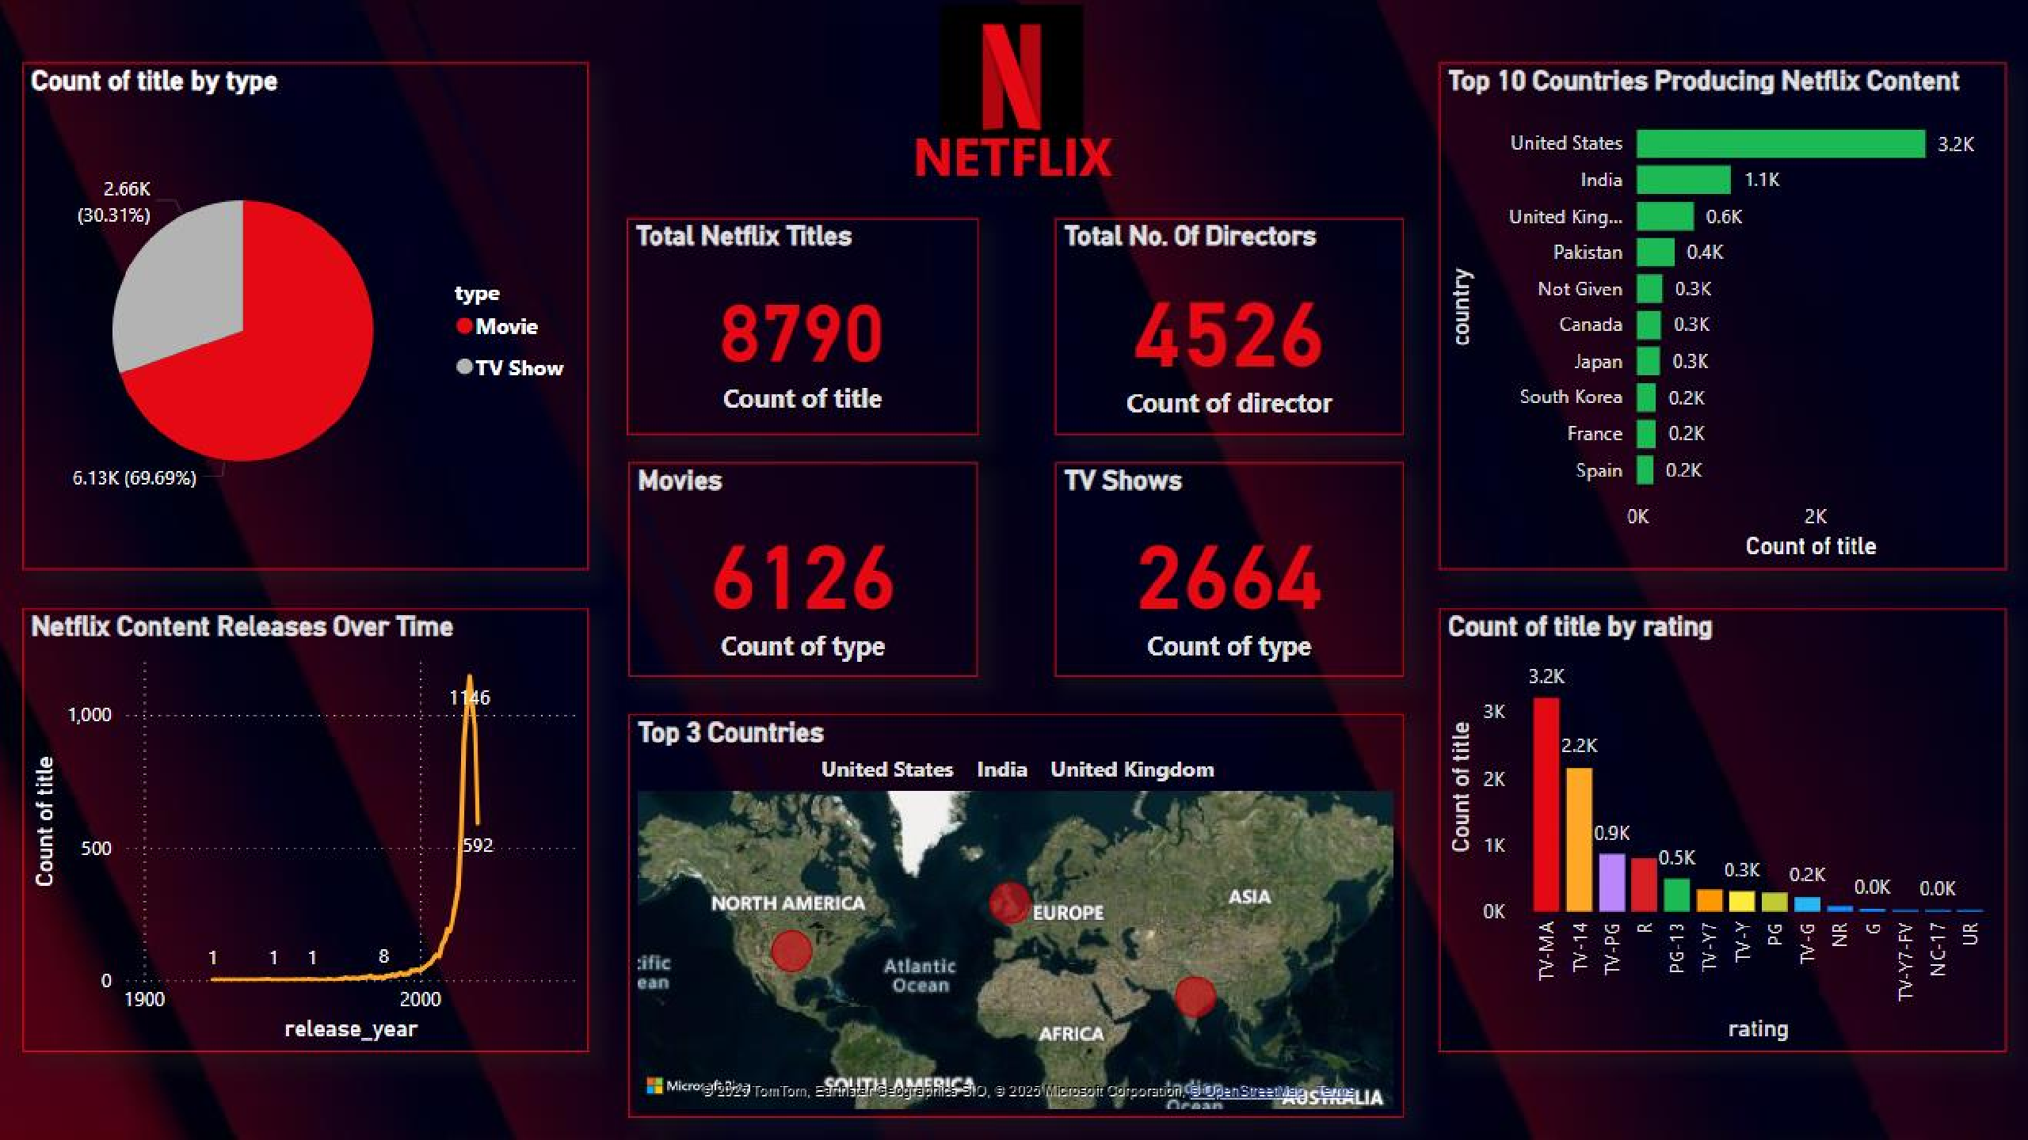



Slide 20



CONCLUSION
Netflix has become a global content powerhouse, with Movies dominating (70%) of its library while TV Shows continue to grow. The United States, India, and the UK are the top content producers, while South Korea, Spain, and Brazil are emerging players. TV-MA is the most common rating, reflecting Netflix’s focus on mature audiences, and Drama, Thriller, and Documentary are the most
popular genres, with Comedy gaining traction. Content production has grown exponentially post-2015,
showing Netflix’s aggressive expansion strategy. To maintain its competitive edge, Netflix should
leverage AI-powered recommendations, invest more in regional content, and optimize marketing strategies using data-driven insights to enhance user engagement and retention.

Slide 21


THANK YOU

